Slide 1
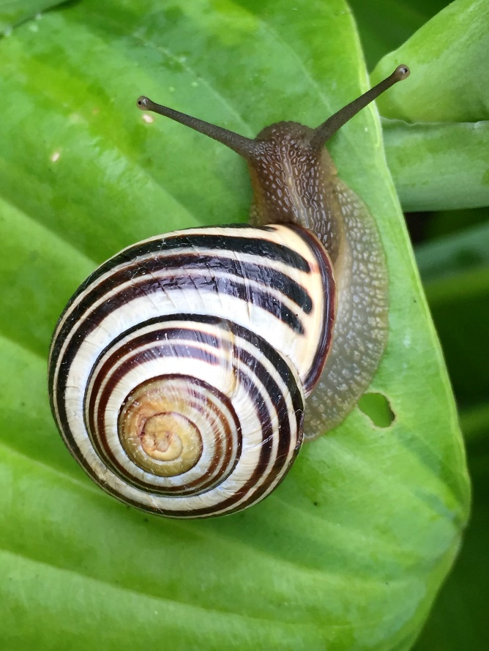


Invertebrate Morphology
All photos used are free-use, public domain unless otherwise noted.

Slide 2
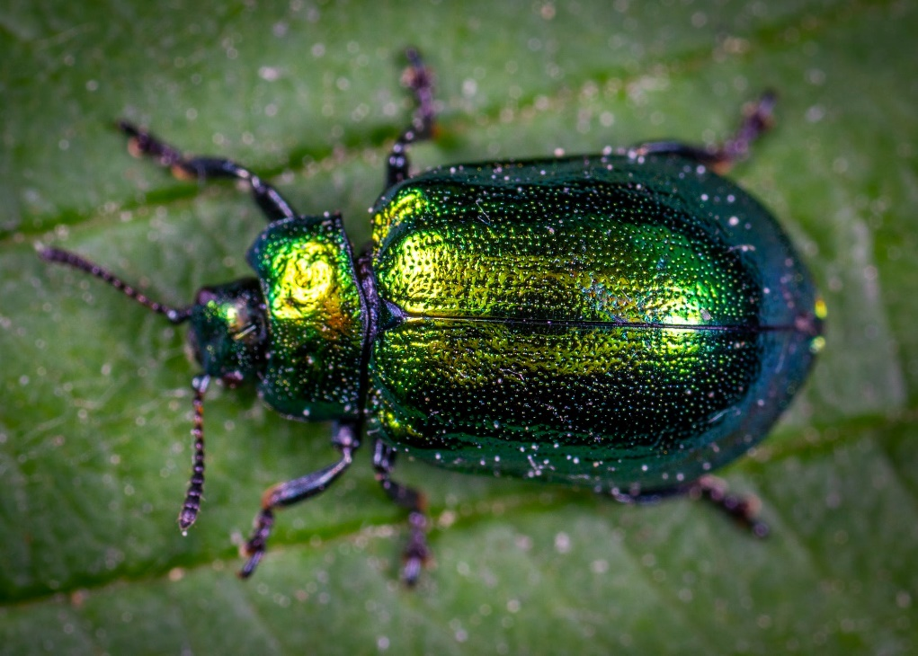
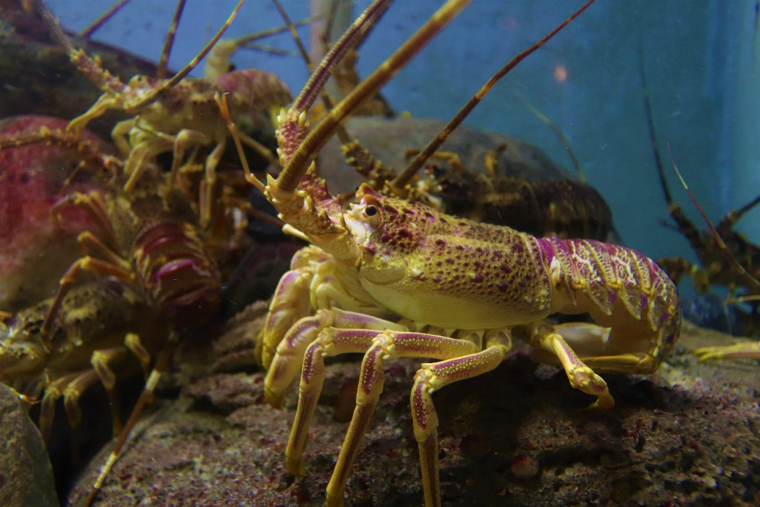
Chitin exoskeleton
Jointed antennae
Jointed legs
Waterproof skin (fully terrestrial)
Aquatic or marine (not terrestrial)
Notes:
chitin exoskeleton: an external skeleton made of the polysaccharide, chitin, as seen in arthropods.
“waterproof skin”: an exoskeleton on a fully terrestrial organism, as opposed to an aquatic or marine-dwelling organism.
Both of the organisms pictured here have jointed legs and jointed antennae.

Slide 3
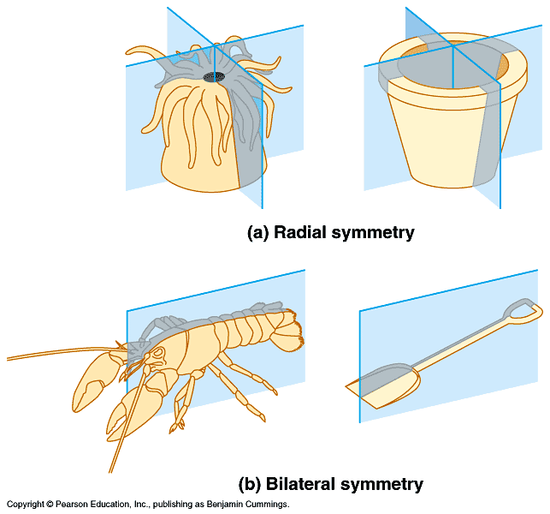
Symmetry:
Grasping claws
Notes:
Radial symmetry: symmetry around a central axis. In other words, it means you could split the subject down the middle multiple times into approximately equal parts.
Bilateral symmetry: being divisible into symmetric halves. This means you can split the subject down the middle just once into approximately equal parts.
Please note that for the purposes of this lab, we consider radial symmetry to be a general term describing the physical appearance of an organism, and not necessarily the term used to describe the structural development of an organism.
The lobster pictured here has bilateral symmetry. It also has two grasping claws.

Slide 4
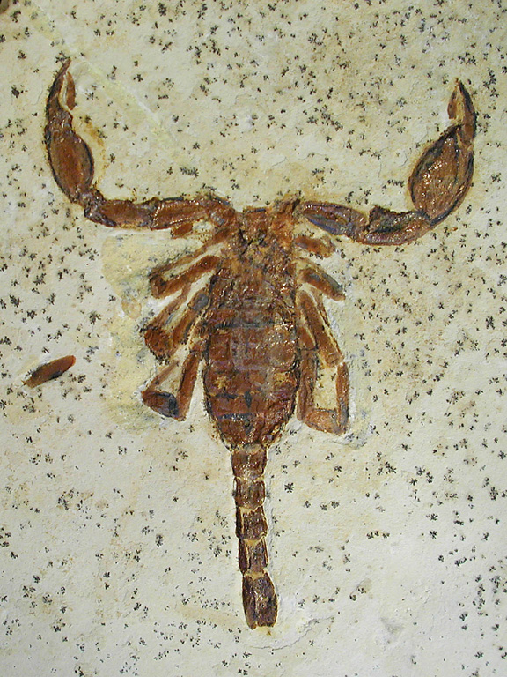
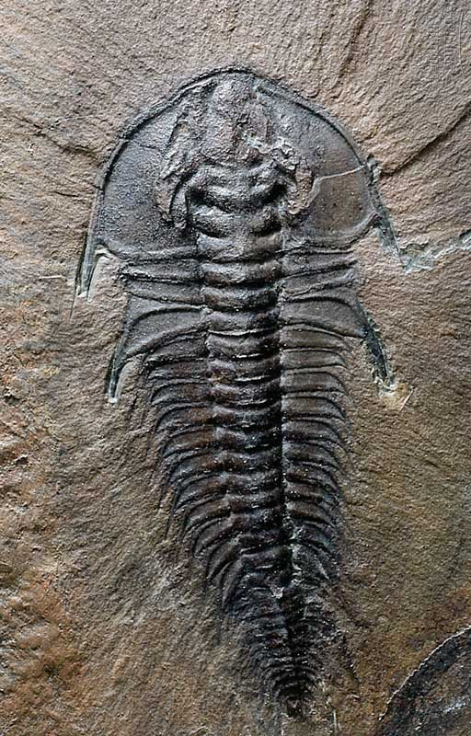
Segmentation:
Notes:
Segmentation: repeated body parts or sections that look relatively similar.

Slide 5
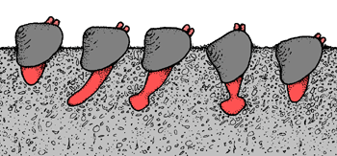
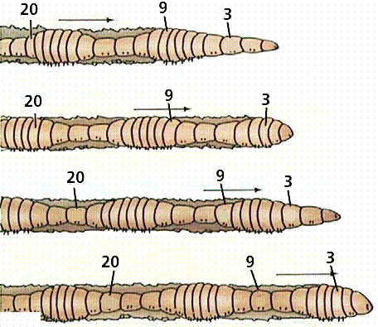
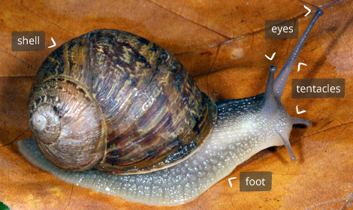
Hydrostatic “foot”:
Earthworm movement:
Mollusc “foot”:
Calcium carbonate shell
Notes:
hydrostatic “foot”: a membrane that uses fluid pressure to expand and contract the structure to allow for movement. For example, if you look at segment 9 of the earthworm, it begins contracted, but expands to propel the worm forward.
calcium carbonate shell: a protective shell (not exoskeleton)

Slide 6
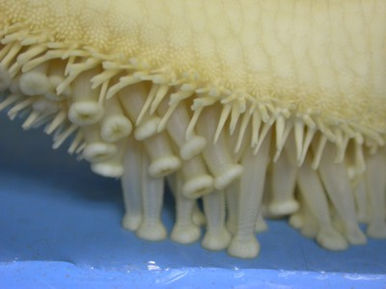
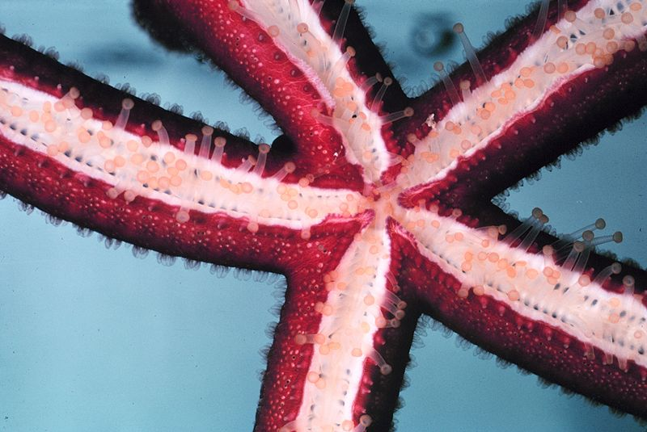
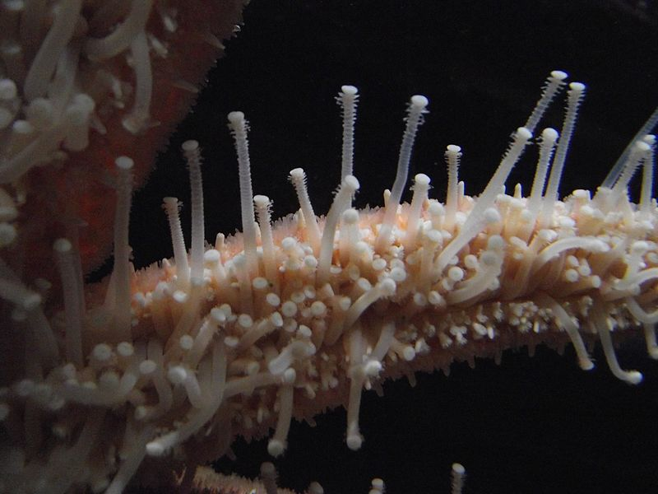
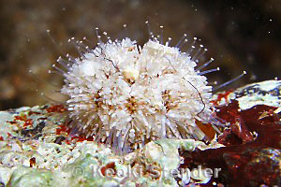
Tube-feet:
Notes:
Tube-feet: hollow, flexible structures operated by hydraulic pressure that allow for movement or food collection. They may be small and difficult to see on some organisms.
If you are having difficulty determining the traits of the species in this lab, it might help to do a bit of online research as you complete the assignment.

